Slide 1
Digital Signal Processing
Abu saleh Musa Miah
Lecturer, Dept. of CSE, BAUST, Bangladesh email: musa@baust.edu.bd, tel: +88-01727-786600 web: www.baust.edu.bd/cse

Slide 2
Digital Signal Processing
www.tutorialcare.com/DSP
Textbook：
Digital signal processing - Principles, algorithms and application (3nd Edition)
J G Proakis, D G Manolakis
Reference for experiment：
Slicer_Digital_Signal_Processing_Using_MATLAB_
3rd_Edition
Textbook for Shortcut Understanding：
Understanding Digital Signal Processing
Richard G.Lyons

Slide 3
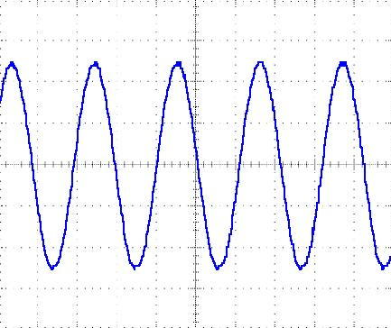
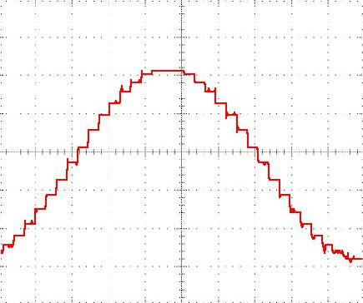
What is DSP?
DSP’s process signals
Converting a continuously changing waveform (analog) into a series of discrete levels (digital)

Slide 4
What is digital signal processing (DSP)?
Digital Signal Processing is a field of numerical mathematics that is concerned with the processing of discrete signals
This area of mathematics deals with the principles that underlie all digital systems

Slide 5
Typical System Components

Slide 6
Application Areas of DSP:
EEG signal process
Enhancement-noise filtering
Coding, synthesis, and recognition
Classification
Speech signal processing,
Enhancement-noise filtering
Coding, synthesis, and recognition
Classification
Sonar and radar signal processing, ,
Digital image processing,
Signal processing for communications,
Control of systems,
Biomedical signal processing,
Seismic data processing, etc.

Slide 7
Applications of DSP: Biological signal
Examples:
Brain signals (EEG)
Cardiac signals (ECG)
Medical images (x-ray, PET, MRI)
Goals:
Detect abnormal activity (heart attack)
Help physicians with diagnosis
Tools: Filtering, Fourier Transform

Slide 8
Applications of DSP: Biometrics
Identifying a person using physiological characteristics
Examples:
Fingerprint Identification
Face Recognition
Voice Recognition

Slide 9
What is Signal?
A flow Information
A detectable physical quantity or impulse (as a voltage, current, or magnetic field strength) by which messages or information can be transmitted (Webster Dictionary)
Varies with time, space or any other independent variable or variables.

Slide 10

What is Signal?
A system is defined as a physical device that perform an operation on a signal.
Example: A filter used to reduce noise.
Systems respond to signals and produce new signals
Excitation signals are applied at system inputs and response signals are produced at system outputs

Slide 11
System
the system is characterized by the type of operation that it performs on the signal.
If the operation is linear, the system is called linear. If the operation on the signal is nonlinear, the system is said to be nonlinear, and so forth.
Such operations are usually referred to as signal processing.

Slide 12
Signal
Signal Characteristics:
Signals are Physical Quantities:
Signals are Measurable
Signals are Analog
Signals Contain Information.
Examples:
Temperature [ºC]
Pressure [Newtons/m²] or [Pa]
Mass [kg]
Speed [m/s]
Acceleration [m/s²]
Torque [Newton*m]
Voltage [Volts]
Current [Amps]
Power [Watts]
In this class, analog signals are electrical.
Sensors: are devices that convert other physical quantities (temperature, pressure, etc.) to electrical signals.

Slide 13
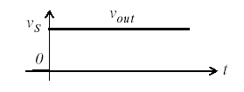

Example of Signal
Simple form of signal is DC (Direct Current) signal as in Figure 1.
Figure1: DC Signal.
The output voltage v_{out} is defined by the following equation:

Slide 14
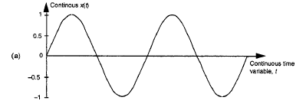
Example of Signal
if v_{s}=5, we can write the signal as x(t)=5 is a very simple form of signal.
Another form of signal is AC (Alternating Current) signal as in figure 2.
Figure 2: A continuous time signal x(t).

Slide 15
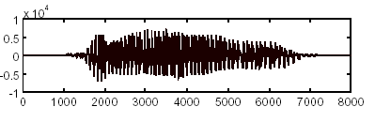
Example of Signal
Human vocal mechanism produces speech. Where acoustic pressure is as a function of time t. We can convert this into electrical signal using microphone and this is called speech signal. This signal is complex and can not be represented easily. Figure 3 shows speech signal.
Figure 3: speech signal or acoustic signal.
In Image signal, where a picture can be represented by brightness as a function of two spatial variables f(x,y) as in figure 4.

Slide 16
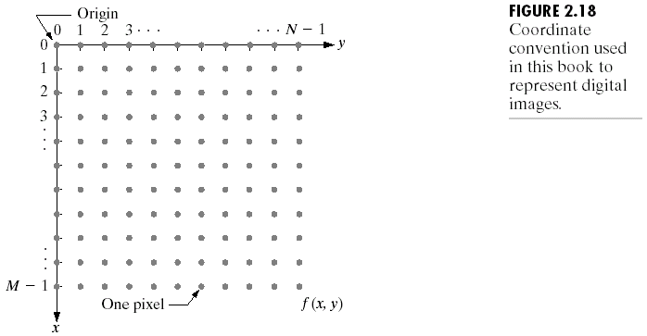
Example of Signal
Figure 4: Picture elements and coordinate to represent digital image.

Slide 17
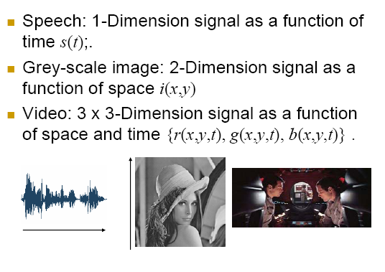
Signal (Example)

Slide 18
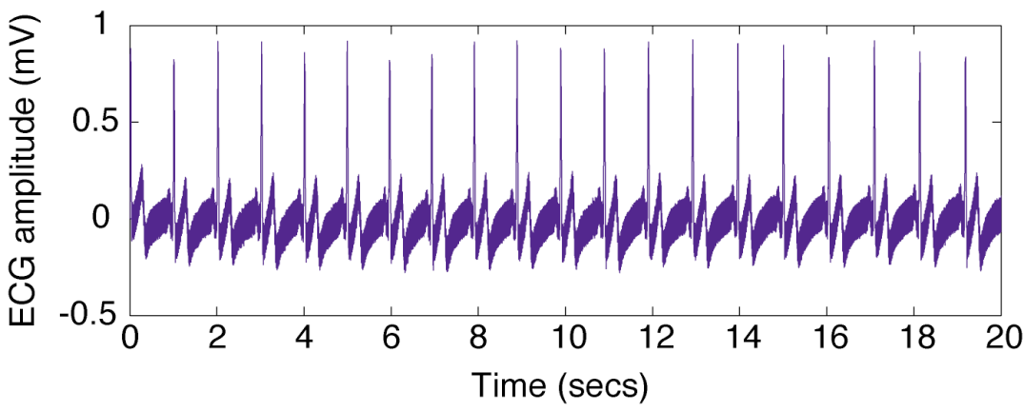
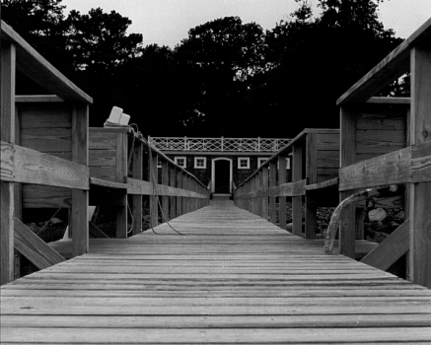
Independent Variable
Time is often the independent variable for a signal. x(t) will be used to represent a signal that is a function of time, t.
A temporal signal is defined by the relationship of its amplitude (the dependent variable) to time (the independent variable).
An independent variable can be 1D (time), 2D (space), 3D (space) or even something more complicated.
The signal is described as a function of this variable.
There are many types of functions that can be used to describe signals (continuous, discrete, random).

Slide 19
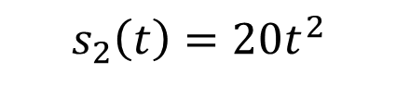
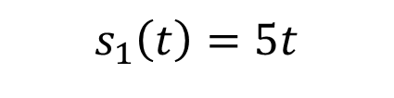
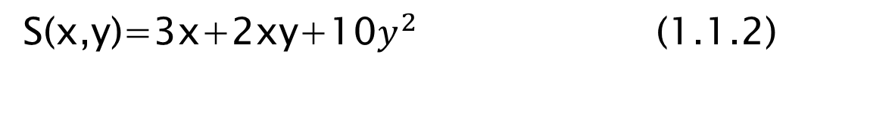

Signal
$$s_{1}\left(t\right)=5t$$
(1.1.1)
$$s_{2}\left(t\right)=20t^{2}$$
describe two signals. one that varies linearly with the independent variable r (time)
and a second that varies quadratic ally with t .
As another example, consider the function
$$A=πr^{2}$$
S(x,y)=3x+2xy+10$y^{2}$ (1.1.2)

Slide 20
Signal
The signals described by (2.1.1) and (1.1.2) are class of signals defined functional dependence on independent variable.
However, there are cases functional relationship is unknown or highly complicated in practical use.
For example, a speech signal (see Fig. 1.1) cannot be described functionally by expressions such as (1.1.1).
In general, a segment of speech represented to a high degree of accuracy as a sum of several sinusoids of different amplitudes and frequencies, that is, as

Slide 21

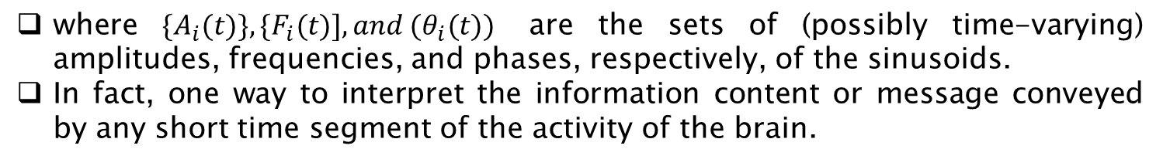
Signal
where $\{A_{i}(t)\}, \{F_{i}(t)], and (θ_{i}(t))$ are the sets of (possibly time-varying) amplitudes, frequencies, and phases, respectively, of the sinusoids.
In fact, one way to interpret the information content or message conveyed by any short time segment of the activity of the brain.

Slide 22
Signal
Speech, electrocardiogram(ECG) and electroencephalogram (EEG) signals are single independent variable. namely time.
Two independent variables is an image signal.
Speech signals are generated by forcing air through the vocal cords.
Vocal cords and the vocal tract, also called the vocal cavity.
Images are obtained from photographic film to a scene.
Signal generation is usually associated with a system that responds to a stimulus or force.
The stimulus in combination with the system is called a signal source.

Slide 23
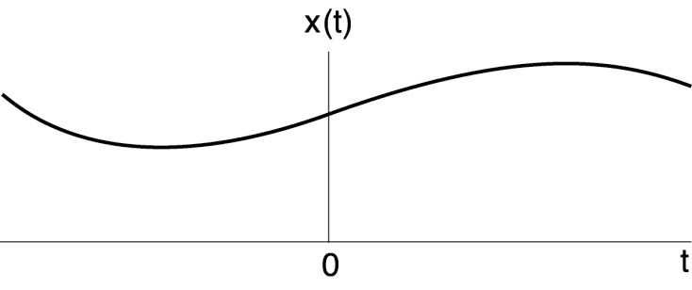
Analog or continuous Time Signal
Most of the signals in the physical world are CT signals, since the time scale is infinitesimally fine (e.g., voltage, pressure, temperature, velocity).
Often, the only way we can view these signals is through a transducer, a device that converts a CT signal to an electrical signal.
Common transducers are the ears, the eyes, the nose… but these are a little complicated.
Simpler transducers are voltmeters, microphones, and pressure sensors.

Slide 24
Analog Signal
Amplitude
Phase
Frequency
x(t) = 5 cos (2.pi.f.t)
x(t) = 5 cos (2.pi.f.t + 3.14)
x(t) = 5 cos (3. 2.pi.f.t + 3.14)

Slide 25
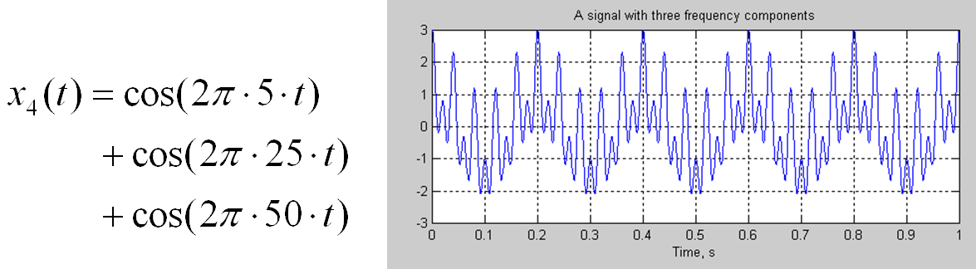
Signal in Time Domain
Stationary signal
Frequency content of stationary signals do not change in time.
All frequency components exist at all times

Slide 26
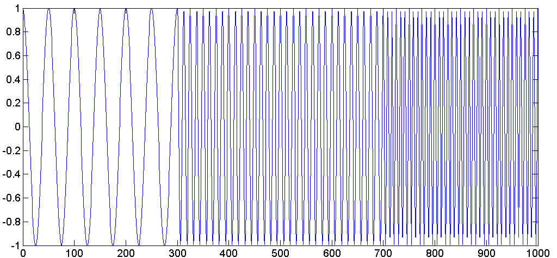
Signal in Time Domain
Non-Stationary signal
Frequency content of stationary signals change in time.
Magnitude
20 Hz
80 Hz
120 Hz

Slide 27
Signal in Time Domain
Speech and noise signal
Speech is the message content or information conveyed
Noise is the unwanted signal that interfere
Speech
Broad band (100-10000Hz)
Non-stationary
Noise
Unknown
Slowly varying (fan) or
non-stationary (babble)
wideband or narrow band

Slide 28

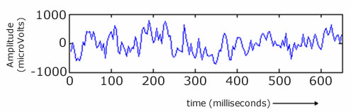
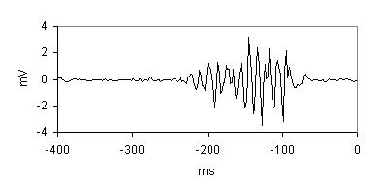
Signal in Time Domain
Almost all biological signals are non-stationary. Some of the most famous ones are ECG (electrical activity of the heart, electrocardiograph), EEG (electrical activity of the brain, electroencephalogram), and EMG (electrical activity of the muscles, electromyogram).
ECG
EEG
EMG

Slide 29
Why signals should be processed?
Signals are carriers of information
Useful and unwanted
Extracting, enhancing, storing and transmitting the useful information
Amplitude
Phase
Frequency
Spectral Content
How signals are being processed?---
Analog Signal Processing vs.
Digital Signal Processing

Slide 30
Comparison of DSP over ASP
-Advantages
Developed Using Software on Computer;
Working Extremely Stable;
Easily Modified in Real Time ;
Low Cost and Portable;
-Disdvantages
Lower Speed and Lower Frequency

Slide 31
Concept Frequency in CT and Discrete signal
From physics we know that frequency is closely related to a specific type of periodic motion called harmonic oscillation.
which is described by sinusoidal functions.
Periodicity
Recall if a signal x(t) is periodic, then there exists a T>0 such that x(t) =x(t+T) If no T>0 can be found, then x(t) is non-periodic.

Slide 32

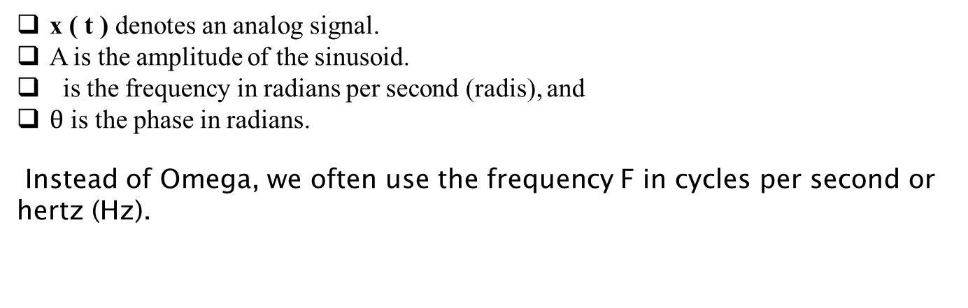
Continuous-Time Sinusoidal Signals
A simple harmonic oscillation is mathematically :
x ( t ) denotes an analog signal.
A is the amplitude of the sinusoid.
is the frequency in radians per second (radis), and
$θ$ is the phase in radians.
Instead of Omega, we often use the frequency F in cycles per second or hertz (Hz).

Slide 33
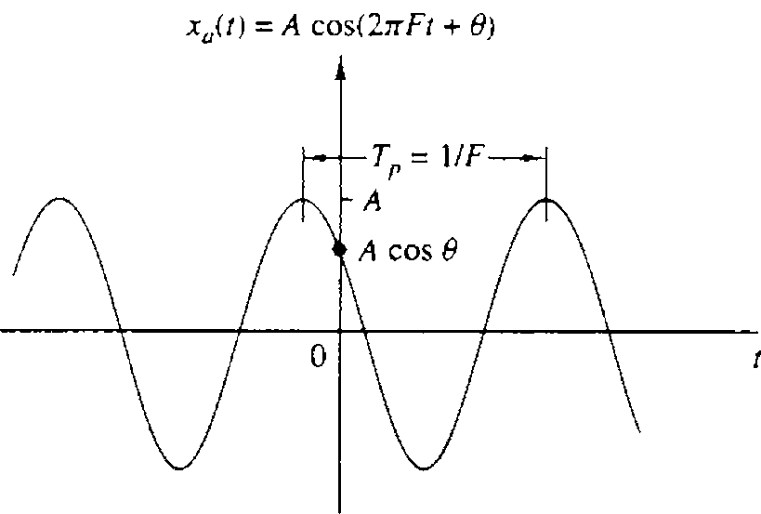
Continuous-Time Sinusoidal Signals
Figure 1.10 Example of an analog sinusoidal signal.

Slide 34
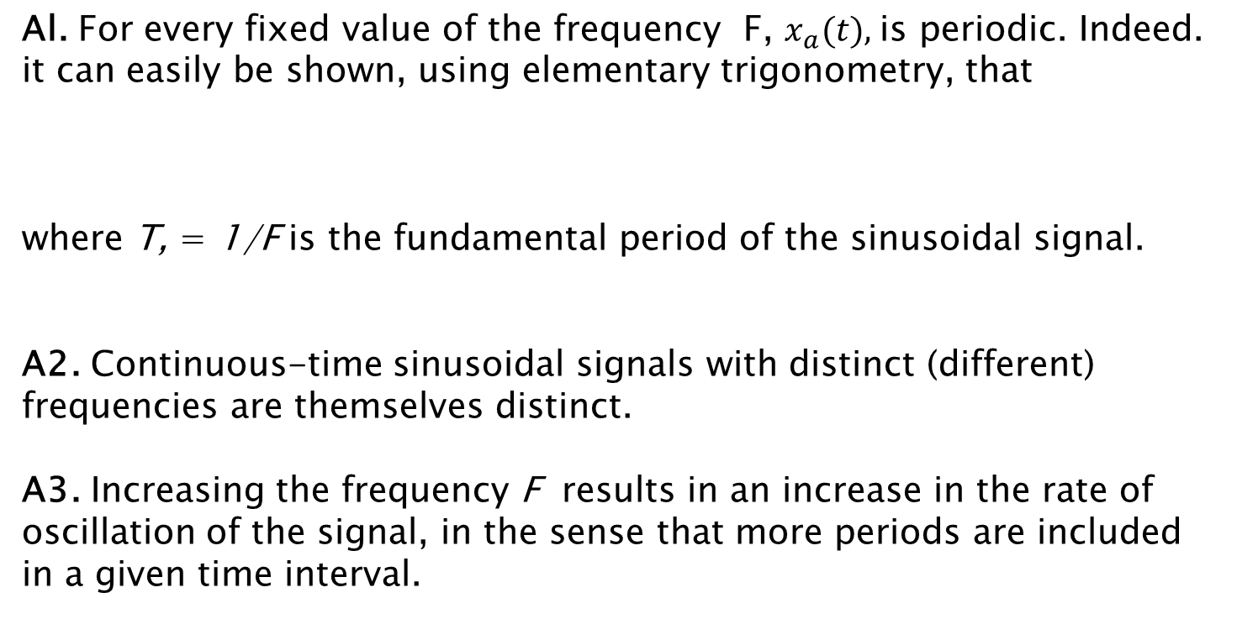
Properties of C Sinusoidal Signals
Al. For every fixed value of the frequency F, $x_{a}(t),$is periodic. Indeed. it can easily be shown, using elementary trigonometry, that
where T, = 1/F is the fundamental period of the sinusoidal signal.
A2. Continuous-time sinusoidal signals with distinct (different) frequencies are themselves distinct.
A3. Increasing the frequency F results in an increase in the rate of oscillation of the signal, in the sense that more periods are included in a given time interval.

Slide 35
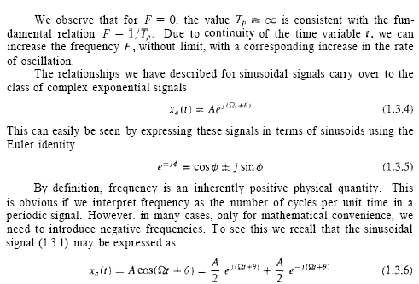
Properties of C Sinusoidal Signals

Slide 36

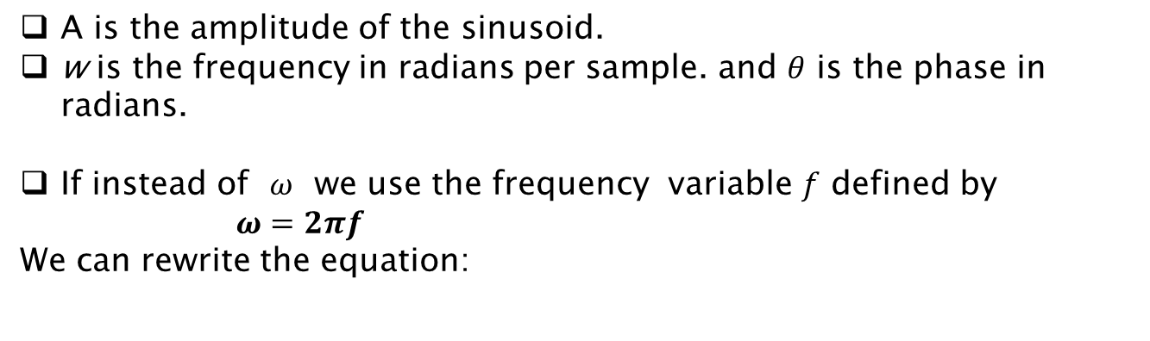
Discrete time Sinusoidal Signals
A discrete-time sinusoidal signal may be expressed as
A is the amplitude of the sinusoid.
w is the frequency in radians per sample. and $θ$ is the phase in radians.
If instead of $ω$ we use the frequency variable $f$ defined by
$ω=2πf$
We can rewrite the equation:
Figure 1.12 shows a sinusoid with frequency w = /6 radians per sample (f = & cycles per sample) and phase 6 = 17/3.

Slide 37
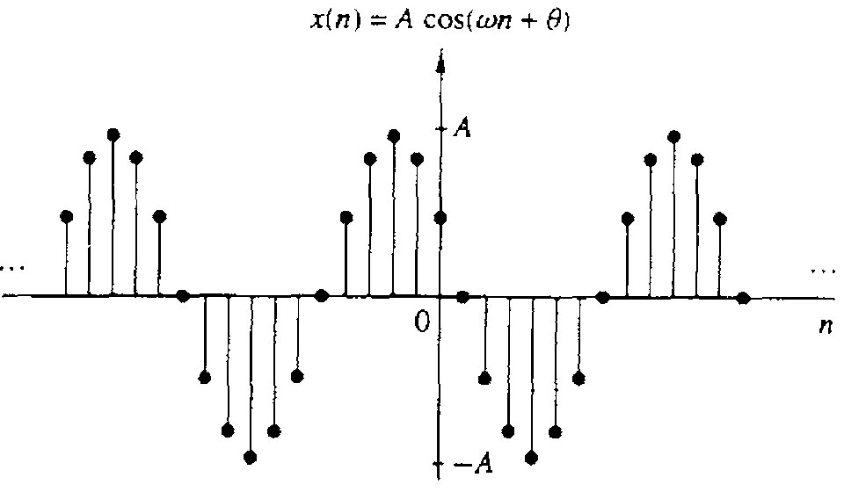
Discrete time Sinusoidal Signals

Slide 38


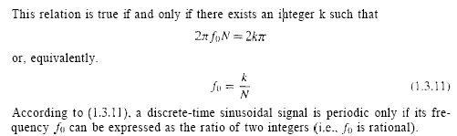
Properties of Discrete time Sinusoidal Signals
B1. A discrete-time sinusoid is periodic only if its frequent?. f is a rational number. When
Proof:

Slide 39
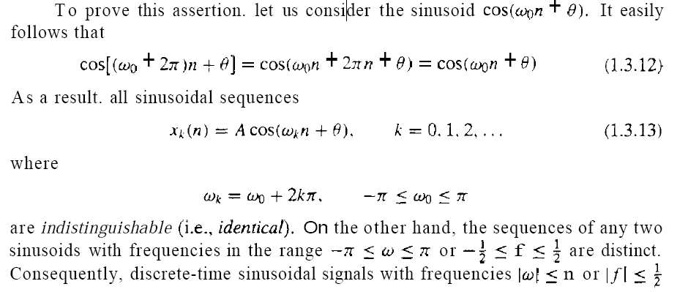
Properties of Discrete time Sinusoidal Signals
B2. Discrete-time sinusoids whose frequencies are separated by an integer multiple of $2π$ are identical.

Slide 40
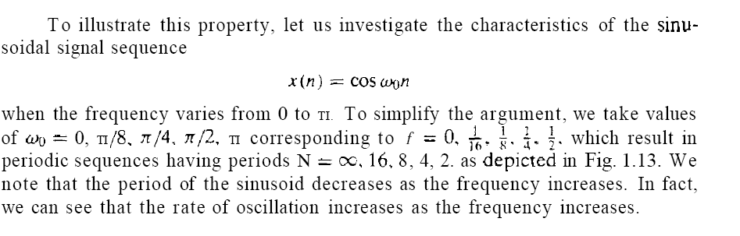
Properties of Discrete time Sinusoidal Signals
B3. The highest rate of oscillation in a discrete-time sinusoid is attained

Slide 41
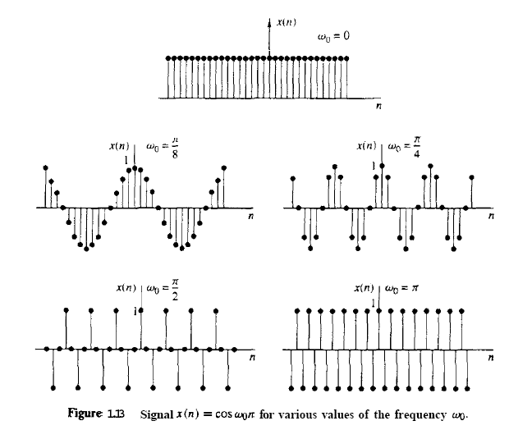
Properties of Discrete time Sinusoidal Signals

Slide 42
Analog to Digital Recording Chain
ADC
Microphone converts acoustic to electrical energy. It’s a transducer.
Continuously varying electrical energy is an analog of the sound pressure wave.
ADC (Analog to Digital Converter) converts analog to digital electrical signal.
Digital signal transmits binary numbers.
DAC (Digital to Analog Converter) converts digital signal in computer to analog for your headphones.

Slide 43
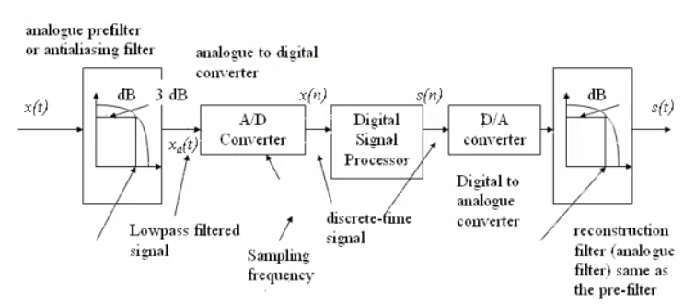
DSP System

Slide 44
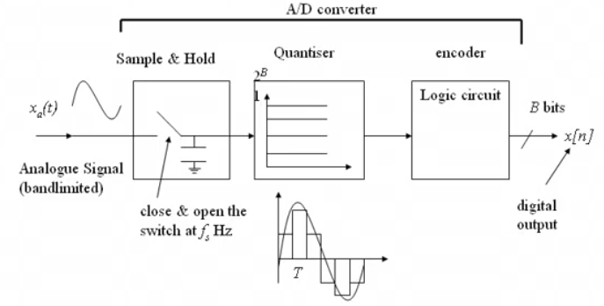
A/D conversion

Slide 45
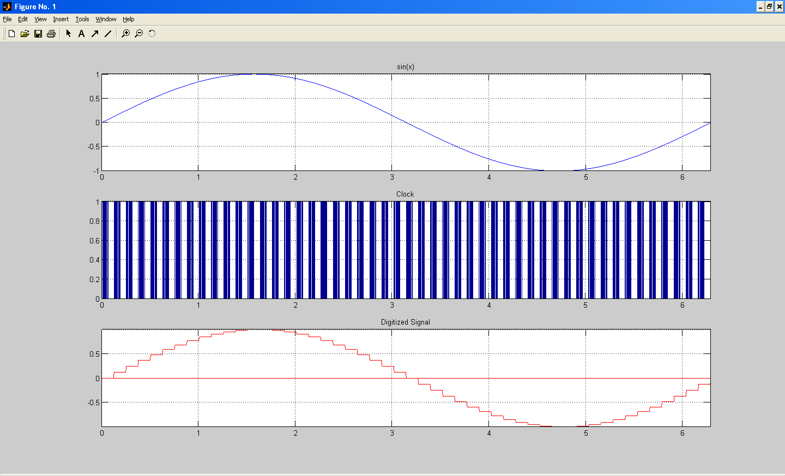
Example of ADC

Slide 46
Analog to Digital (A/D) Conversion
To process analog signals by digital means,
First necessary to convert them into digital form, that is, to convert them to a sequence of numbers having finite precision.
This process is called analog-to digital (A/D) conversion.
A/D conversion has Three steps
Sampling
Quantization
Coding

Slide 47
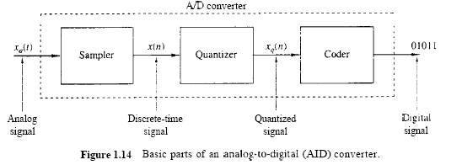
1-Sampling
Conversion of a continuous-time signal into a discrete-time signal. It is called samples. Thus if x_{a}(t) is the input to the sampler, the output is x_{a} (nt) = x(n), where T is the sampling interval.
Here t is the sampling interval generally sampling rate is at least double of the frequency.

Slide 48
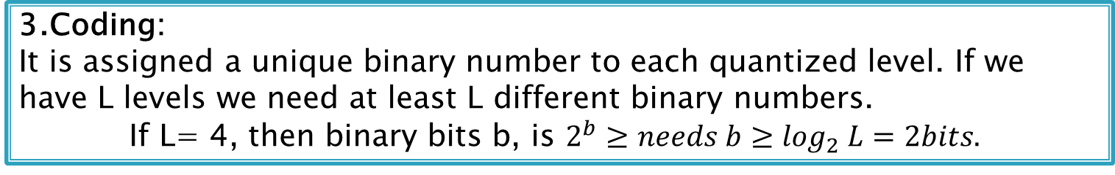
2-Quantization
Quantization is the process of converting the sampled analog voltages into digital words.
converting a continuous range of values into a finite range of discrete values.
We denote the quantization operation on the samples x(n) as Q[x(n)] and let x_{q}(n) denote the sequence of quantized samples at the output of the quantizer. Hence
x_{q}(n)= Q[x(n)]
Error, e_{q}(n)= x_{q}(n)-x(n)
The difference between unquantize sample x(n) and quantized sample $x_{q\left(n\right)}$ is called quantization error
3.Coding:
It is assigned a unique binary number to each quantized level. If we
have L levels we need at least L different binary numbers.
If L= 4, then binary bits b, is $2^{b}≥needs b≥\log_{2} L=2bits.$

Slide 49
Sampling
Sampling is a continuous to discrete-time conversion
Most common sampling is periodic
T is the sampling period in second
f_{s} = 1/T is the sampling frequency in Hz
Sampling frequency in radian-per-second Ω_{s}=2πf_{s} rad/sec
Use [.] for discrete-time and (.) for continuous time signals
This is the ideal case not the practical but close enough
In practice it is implement with an analog-to-digital converters
We get digital signals that are quantized in amplitude and time
-3
-2
-1
0
1
2
3
4

Slide 50
Periodic Sampling
Sampling is, in general, not reversible
Given a sampled signal one could fit infinite continuous signals through the samples
1
0.5
0
-0.5
-1
0
20
40
60
80
100
Fundamental issue in digital signal processing
If we loose information during sampling we cannot recover it
Under certain conditions an analog signal can be sampled without loss so that it can be reconstructed perfectly

Slide 51
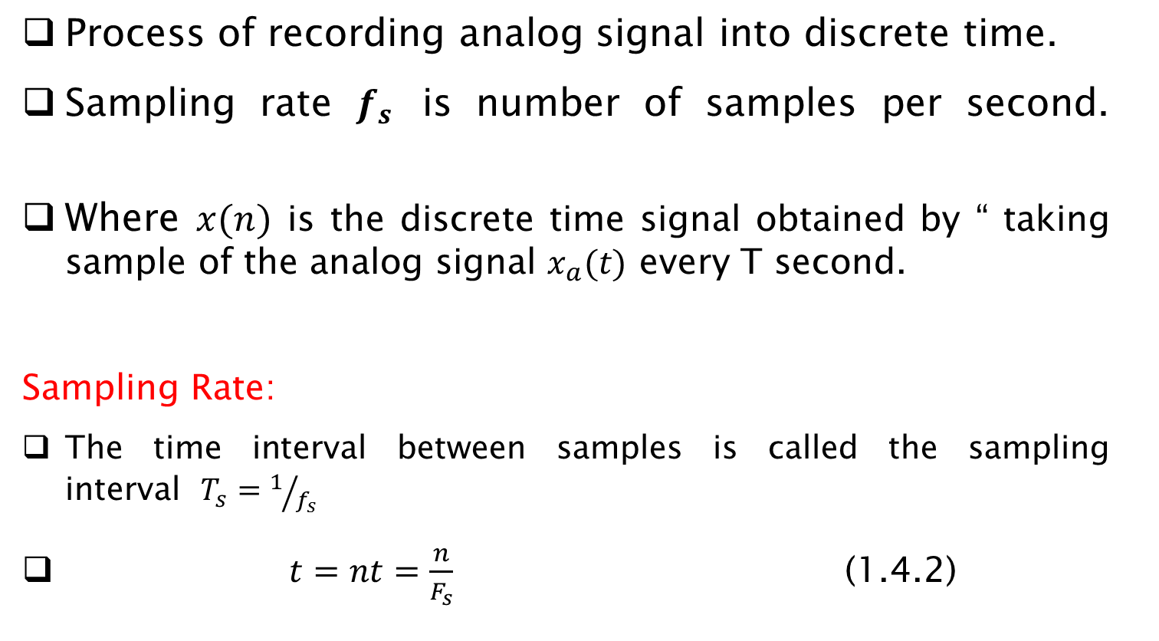

ADC: Step1: Sampling Analog Signal
Process of recording analog signal into discrete time.
Sampling rate $f_{s}$ is number of samples per second.
Where $x(n)$ is the discrete time signal obtained by “ taking sample of the analog signal $x_{a}(t)$ every T second.
Sampling Rate:
The time interval between samples is called the sampling interval $T_{s}=1/{f_{s}}$
$t=nt=\frac{n}{F_{s}}$ (1.4.2)
$X(n) = x_{a}(nT). −∞ < n < ∞$ (1.4.1)
There exists a relationship between the frequency variable F for analog signals and the frequency variable f for discrete-time signals.

Slide 52
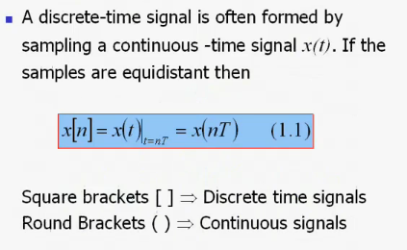
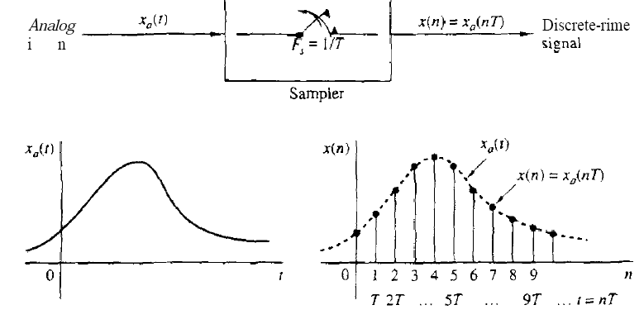
Sampling

Slide 53
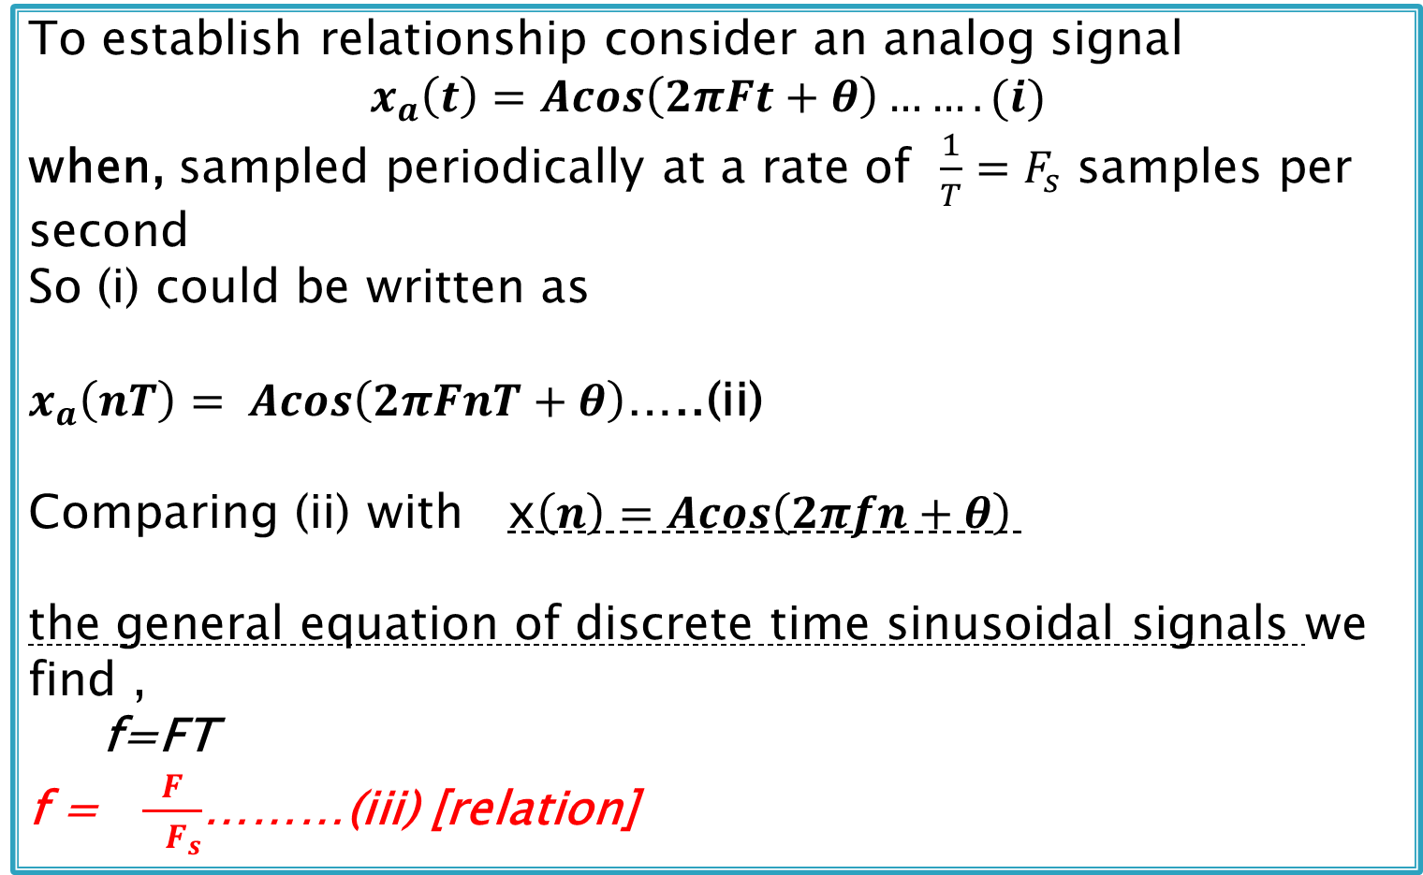
Relationship between the frequency of analog signal and the frequency of discrete-time signal
To establish relationship consider an analog signal
$x_{a}\left(t\right)=Acos\left(2πFt+θ\right)…….(i)$
when, sampled periodically at a rate of $\frac{1}{T}=F_{s}$ samples per second
So (i) could be written as
$x_{a}\left(nT\right)= Acos\left(2πFnT+θ\right)$…..(ii)
Comparing (ii) with x$\left(n\right)=Acos\left(2πfn+θ\right)$
the general equation of discrete time sinusoidal signals we find ,
f=FT
f = $\frac{F}{ F_{s}}$………(iii) [relation]

Slide 54
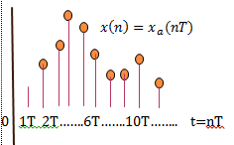
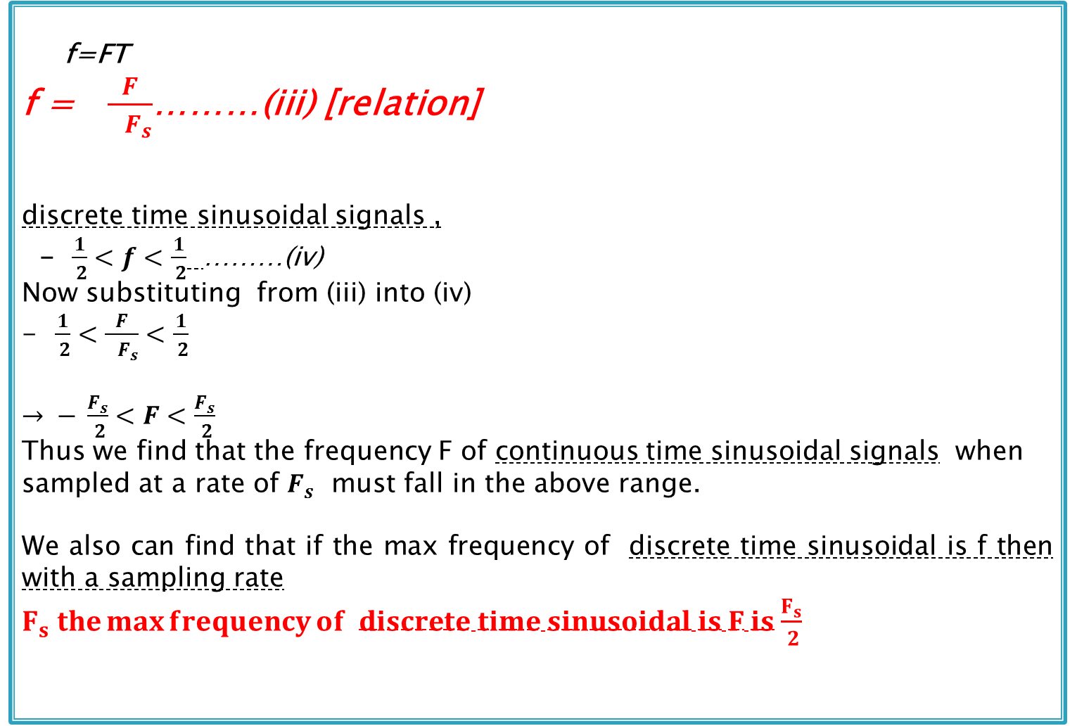
Relationship between the frequency of analog signal and the frequency of discrete-time signal
f=FT
f = $\frac{F}{ F_{s}}$………(iii) [relation]
discrete time sinusoidal signals ,
- $\frac{1}{ 2}<f<\frac{1}{ 2}$ ………(iv)
Now substituting from (iii) into (iv)
$\frac{1}{ 2}<\frac{F}{ F_{s}}<\frac{1}{ 2}$
$→ − \frac{F_{s}}{ 2}<F<\frac{F_{s}}{ 2}$
Thus we find that the frequency F of continuous time sinusoidal signals when sampled at a rate of $F_{s}$ must fall in the above range.
We also can find that if the max frequency of discrete time sinusoidal is f then with a sampling rate
$F_{s} the\max{frequency}of discrete time sinusoidal is F is$ $\frac{F_{s}}{ 2}$

Slide 55

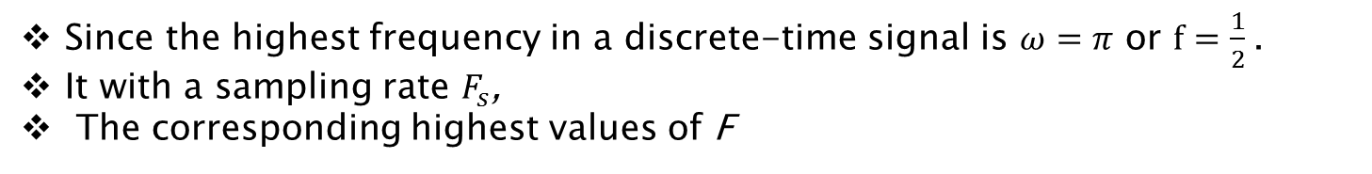
ADC: Step1: Sampling Analog Signal
Since the highest frequency in a discrete-time signal is $ω=π$ or $f=\frac{1}{2}$.
It with a sampling rate $F_{s}$,
The corresponding highest values of F

Slide 56
Sampling
Collect sufficient data for correctly representing a
continuous-time signal

Slide 57
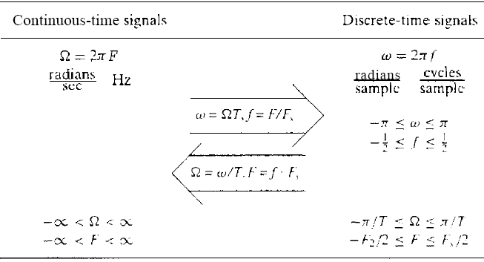
Difference between Continuous and Discrete time signal

Slide 58
Analog to Digital Overview
Sampling Rate
How often analog signal is measured
[samples per second, Hz]
Sampling Resolution
[ “sample word length,” “bit depth”] Precision of numbers used for measurement: the more bits, the higher the resolution.
Example: 16 bit

Slide 59
Sampling Rate/Sampling Theorem
Determines the highest frequency that you can represent with a digital signal.
Sampling/Nyquist Theorem:
Sampling rate must be at least twice as high as the highest frequency you want to represent.
If the highest frequency contained in an analog signal x_{a}(t) is F_{max}. And the signal is sampled at a rate F_{s} >= 2F_{max}, then x_{a}(t) can be exactly recovered from its sample values.
The sampling rate, F_{S} >=2F_{max} is called the Nyquist rate.

Slide 60
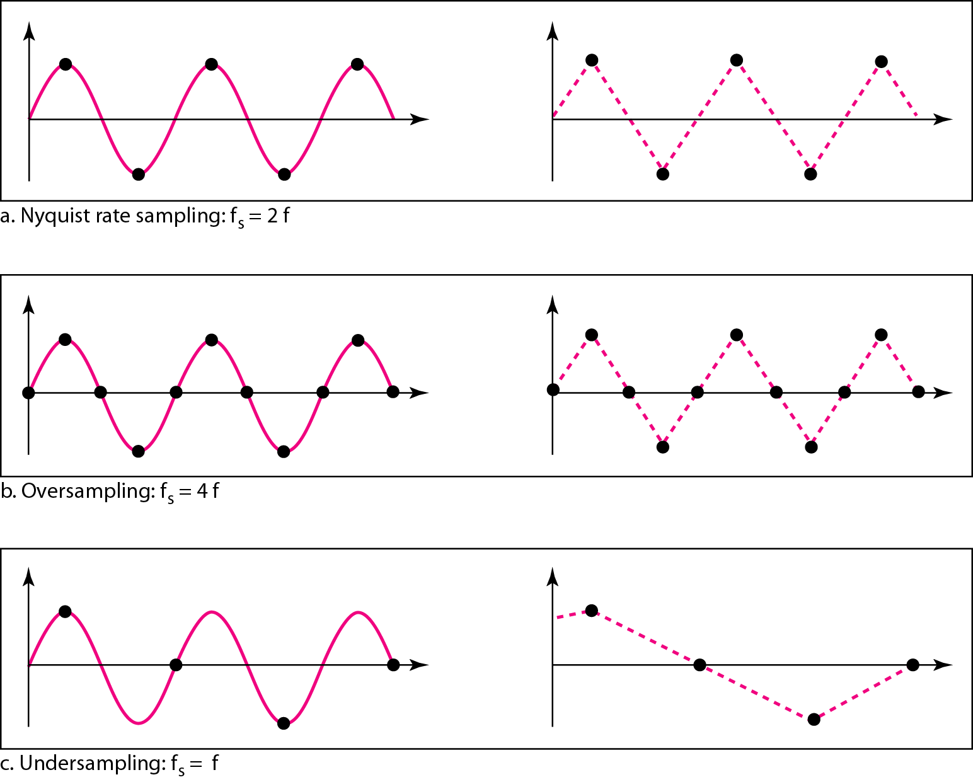
Recovery of a sampled sine wave for different sampling rates

Slide 61
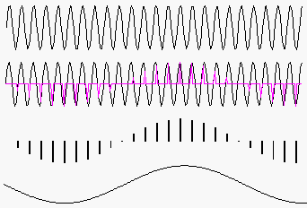
Aliasing: signal ambiguity in FD
What happens if sampling rate not high enough?
A high frequency signal
sampled at too low a rate
looks like …
… a lower frequency signal.
That’s called aliasing or foldover. An ADC has a low-pass anti-aliasing filter to prevent this.
Synthesis software can cause aliasing.

Slide 62
Anti-Aliasing Filter
An anti-aliasing filter removes frequencies that are higher than half the sampling rate using what is called a low pass filter. A low pass filter lets the low frequencies “pass" and "cut" the high frequencies. Low pass filters are sometimes called high cut filters.

Slide 63
Common Sampling Rates
Which rates can represent the range of frequencies audible by (fresh) ears?
Sampling Rate | Uses
44.1 kHz (44100) | CD, DAT
48 kHz (48000) | DAT, DV, DVD-Video
96 kHz (96000) | DVD-Audio
22.05 kHz (22050) | Old samplers
Most software can handle all these rates.

Slide 64
Step2 Quantization
Process of converting the sampled continuous-Valued signals into discrete-valued data

Slide 65
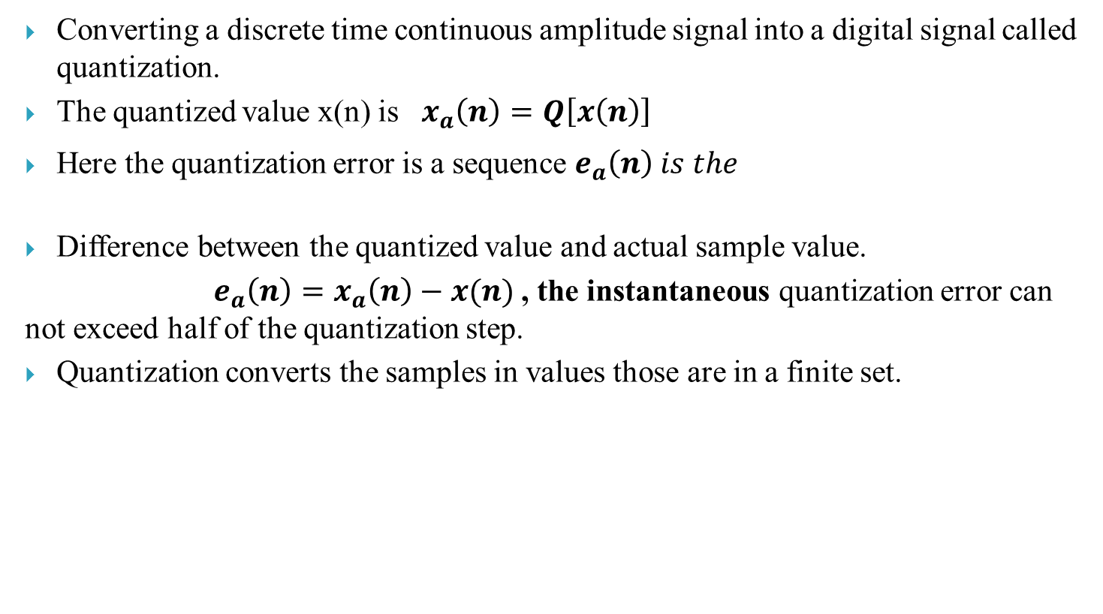
Explain quantization of continuous –amplitude signal
Converting a discrete time continuous amplitude signal into a digital signal called quantization.
The quantized value x(n) is $x_{a}\left(n\right)=Q\left[x\left(n\right)\right]$
Here the quantization error is a sequence $e_{a}\left(n\right) is the$
Difference between the quantized value and actual sample value.
$e_{a}\left(n\right)=x_{a}\left(n\right)−x(n)$ , the instantaneous quantization error can not exceed half of the quantization step.
Quantization converts the samples in values those are in a finite set.

Slide 66
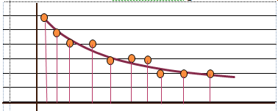

Explain quantization of continuous –amplitude signal
The values allowed in the digital signal called quantization levels.
Distance $∆ ,$ between two successive quantization levels is called quantization step size or resolution .
The rounding quantizer assigns each sample of x(n) to the nearest quantization levels .
Qruncation quantizer assigns each sample of x(n) to the quantization level below to it.

Slide 67
A/D: Step2: Quantization
Amplitude values ranging between two limits: a min and a max.
Amplitude values are infinite between the two limits.
We need to map the infinite amplitude values onto a finite set of known values.
This is achieved by dividing the distance between min and max into L zones, each of height Δ.
Δ = (max - min)/L

Slide 68
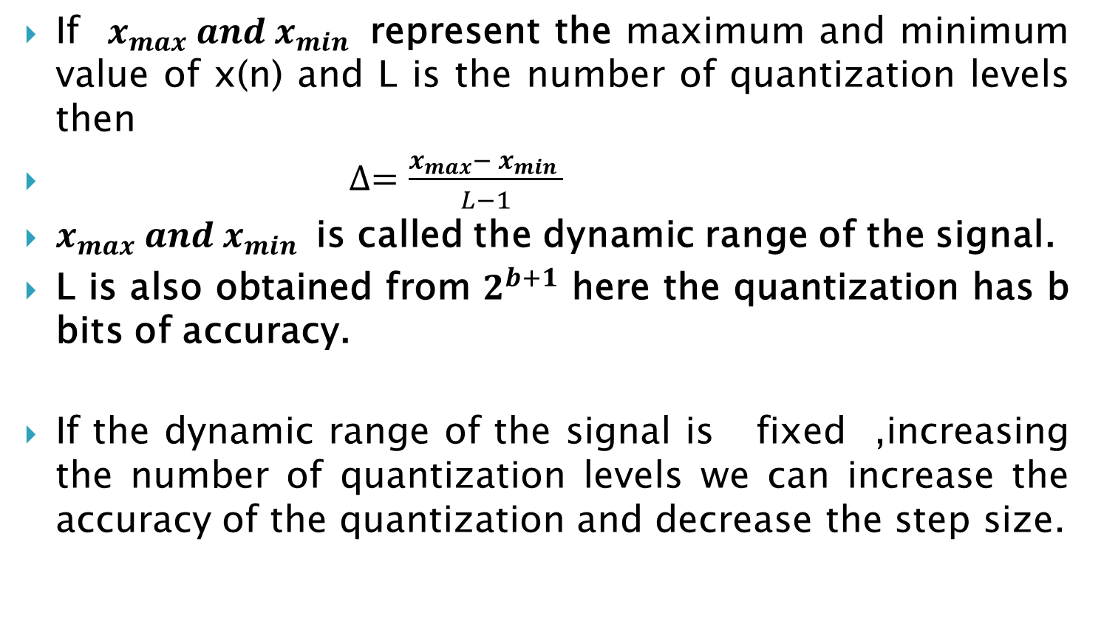
Explain quantization of continuous –amplitude signal
If $x_{max} and x_{min }$ represent the maximum and minimum value of x(n) and L is the number of quantization levels then
$∆=\frac{x_{max}− x_{min }}{L−1}$
$x_{max} and x_{min }$ is called the dynamic range of the signal.
L is also obtained from $2^{b+1}$ here the quantization has b bits of accuracy.
If the dynamic range of the signal is fixed ,increasing the number of quantization levels we can increase the accuracy of the quantization and decrease the step size.

Slide 69
Assigning Codes to Zones
Each zone is then assigned a binary code.
The number of bits required to encode the zones, or the number of bits per sample as it is commonly referred to, is obtained as follows:
n_{b} = log₂ L
Given our example, n_{b} = 3
The 8 zone (or level) codes are therefore: 000, 001, 010, 011, 100, 101, 110, and 111

Slide 70
3-bit Quantization
A 3-bit binary (base 2) number has 2³ = 8 values.
7
6
5
4
Amplitude
3
2
1
0
Time — measure amp. at each tick of sample clock

Slide 71
4-bit Quantization
A 4-bit binary number has 2⁴ = 16 values.
14
12
10
8
Amplitude
6
4
2
0
Time — measure amp. at each tick of sample clock
A better approximation

Slide 72
Quantization Error
When a signal is quantized, we introduce an error - the coded signal is an approximation of the actual amplitude value.
The difference between actual and coded value (midpoint) is referred to as the quantization error.
The more zones, the smaller Δ which results in smaller errors.
BUT, the more zones the more bits required to encode the samples -> higher bit rate

Slide 73
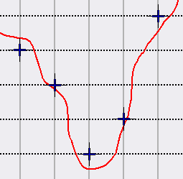
Quantization Noise
Round-off error: difference between actual signal and quantization to integer values…
Random errors: sounds like low-amplitude noise

Slide 74
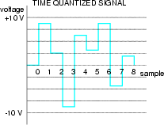
Consider an audio signal with a voltage range between -10 and +10
Assume the audio waveform has already been time sampled, as shown
How can the amplitude also be converted into discrete values?

Slide 75
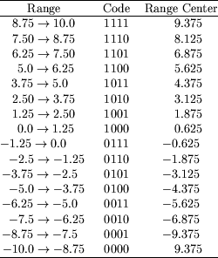

For this example, let’s choose to represent each sample by 4 bits
There are an infinite number of voltages between -10 and 10.
We will have to assign a range of voltages to each 4-bit codeword.
There will be 16 steps. Why?
How large will each step be?

Slide 76
QUANTIZATION

Slide 77
A/D: step3: Coding
Data coding
Data coding separates the digital words so that they are more easily identified.

Slide 78
Digital to Analog Conversion: Sample and Hold
To reconstruct analog signal, hold each sample value for one clock tick; convert it to steady voltage.
7
6
5
4
Amplitude
3
2
1
0
Time

Slide 79
DAC: Smoothing Filter
Apply an analog low-pass filter to the output of the sample-and-hold unit: averages “stair steps” into a smooth curve.
7
6
5
4
Amplitude
3
2
1
0
Time

